Slide 1

HELMET DETECTION USING YOLOV3 AND OPENCV
Mentorness task 2
Lekshmi L

Slide 2
01
Introduction
Our Agenda
for Today
02
Project Setup
Where we are, where we're headed, and our goals
03
YOLOv3 Model
04
Steps Walkthrough
05
Demonstration and Results

Slide 3

Introduction
Overview of Workplace Safety Enhancement

Slide 4

Enhancing Safety Protocols:
Providing continuous and accurate monitoring through automated helmet detection.
Objective
Developing an Automated Helmet Detection System
for Workplace Safety
UtilizingYOLOv3 and OpenCV:
Leveraging YOLOv3 and OpenCV for efficient helmet detection in images and videos.
Reducing Head Injury Risks:
Implementing a solution to enforce helmet-wearing policies and minimize head injury risks.

Slide 5
Project Setup
Establishing the Foundation for Automated Helmet Detection System

Slide 6
Dependencies
Key Libraries for Helmet Detection System
1
2
3
OpenCV
Numpy
Streamlit
OpenCV library provides essential tools for image and video processing in the helmet detection system, enabling functions like image recognition and object tracking.
Numpy supports numerical operations crucial for data manipulation and processing, facilitating mathematical computations and transformations in the helmet detection project.
Streamlit framework plays a vital role in creating user-friendly web interfaces for image and video uploads, enhancing the user experience in the helmet detection system.

Slide 7
Yolov3 Files -
Understanding the Components for Effective Helmet Detection
yolov3.cfg
Configuration file defines network architecture, impacting helmet detection accuracy. Contains hyperparameters.
yolov3.weights
Pre-trained weights file leveraging learned features for accurate helmet detection.
helmet.names
File containing class names like 'helmet' for identifying and labeling helmet objects during detection. Lists the predefined classes or categories the model can identify, enabling accurate classification of detected objects like helmets.

Slide 8

YOLOv3 Model

Slide 9



YOLOv3 Overview
Exploring the Advanced Real-time Object Detection Capabilities
STATE-OF-THE-ART MODEL
HIGH PRECISION
RELEVANCE TO HELMET DETECTION PROJECT
EFFICIENCY IN OBJECT RECOGNITION
YOLOv3 provides cutting-edge real-time object detection, making it a top choice for various projects.
With YOLOv3, achieve high precision in detecting objects swiftly, ensuring accuracy and reliability in results.
The YOLOv3 model's capabilities align perfectly with the requirements of the helmet detection project, enhancing safety measures effectively.
Utilize YOLOv3's efficient object recognition features to detect helmets swiftly and accurately, contributing to workplace safety enhancements.

Slide 10
Phases of Implementation

Slide 11
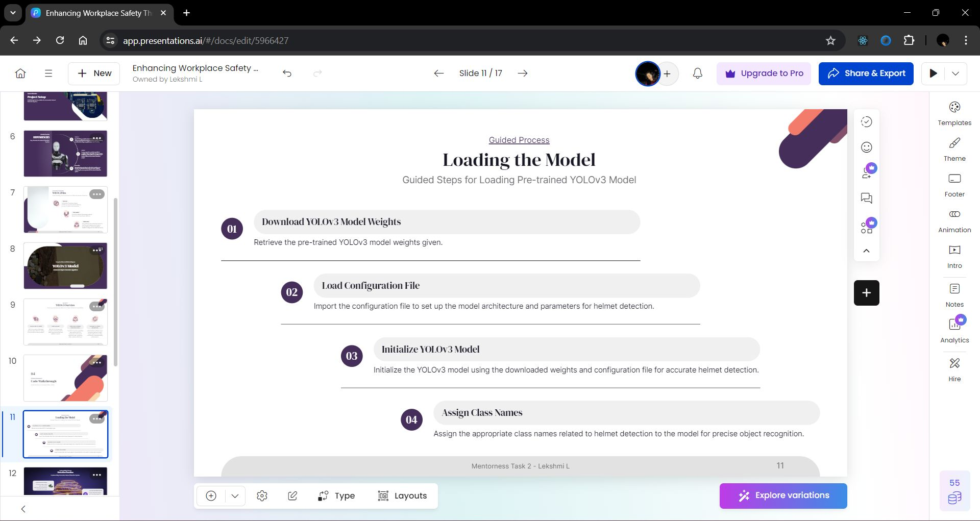

Slide 12
PREPROCESSING IMAGES
Enhance image quality, resize, and adjust brightness for optimal input to the YOLOv3 model.
Detection Function
RUNNING YOLOV3 MODEL
Execute YOLOv3 algorithm to detect helmets within the preprocessed images based on predefined criteria.
DRAWING BOUNDING BOXES
Execute YOLOv3 algorithm to detect helmets within the preprocessed images based on predefined criteria.

Slide 13
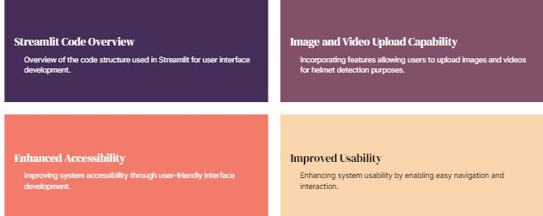
User Interface Development
Enhancing Accessibility and Usability Through Streamlit

Slide 14

DEMONSTRATION AND RESULTS

Slide 15
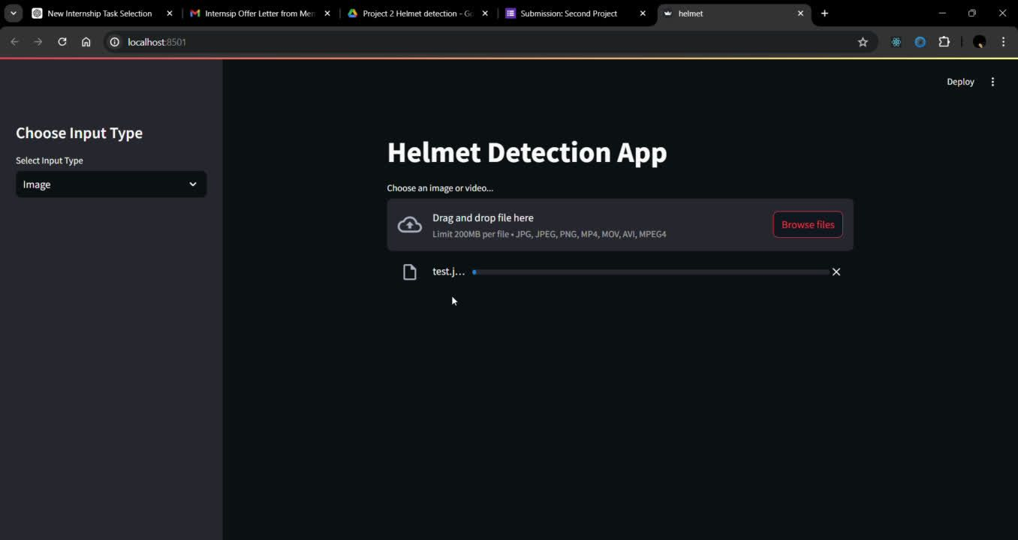

Slide 16
Real-Time Alert System: Implementing real-time notifications for safety compliance.
1
Future Trends/ Works
Mobile App Integration: Developing a mobile app for on-the-go helmet detection and compliance monitoring.
2
3
Further Improvements: Enhancing detection accuracy under different environmental conditions and extending to other safety equipment.

Slide 17

Thank You...

